Slide 1
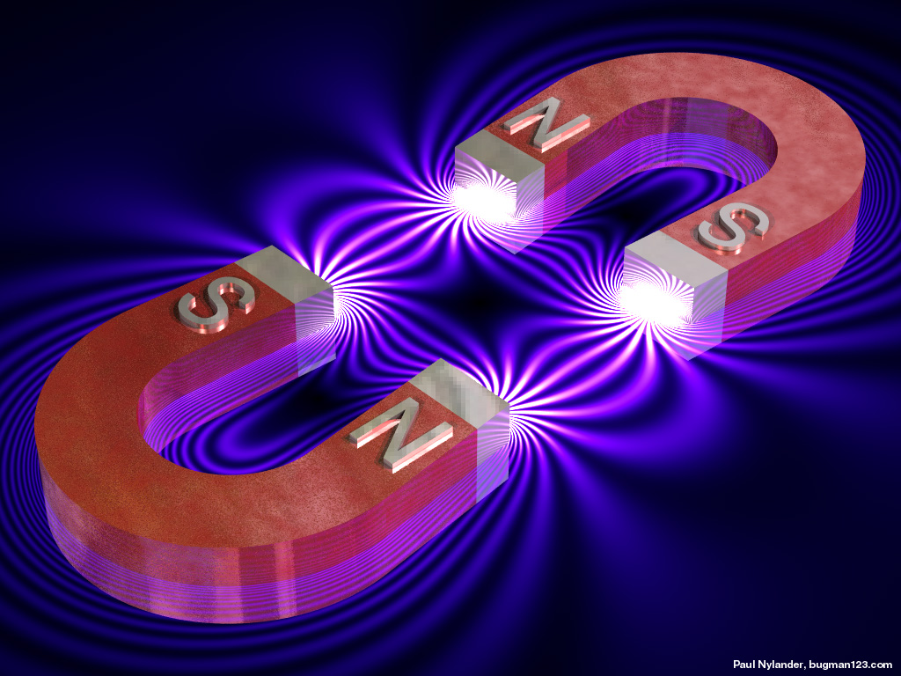
Magnetic Fields
This lesson will introduce you to the concepts associated with magnetism
You will also learn about the magnetic fields and how electricity can be used to create magnetic fields

Slide 2
Learning Goals
By the end of this lesson, you will be able to:
state the law of magnetism
describe magnetic fields and magnetic field lines
state the RHR
solve problems involving RHR

Slide 3
Success Criteria
Can I:
state the law of magnetism
describe magnetic fields and magnetic field lines
state the RHR
solve problems involving RHR

Slide 4

The Law of Magnetism
Every magnet has a north and a south pole
N
S
Similar magnetic poles repel one another with a force.
Dissimilar magnetic poles attract one another with a force

Slide 5
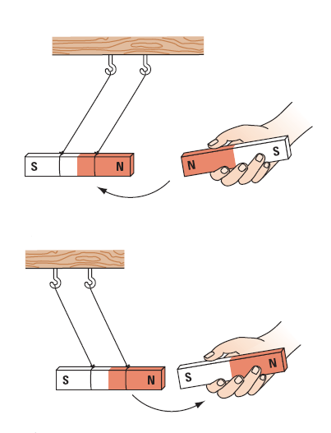

Slide 6
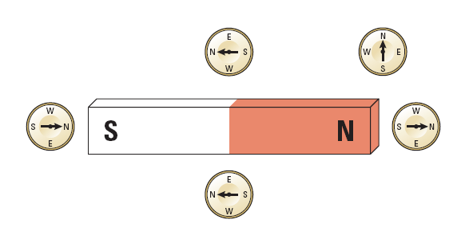
Around all magnets is a magnetic field.
This magnetic field is represented as a series of lines.
The direction of the field outside of the magnet is
from N to S.

Slide 7
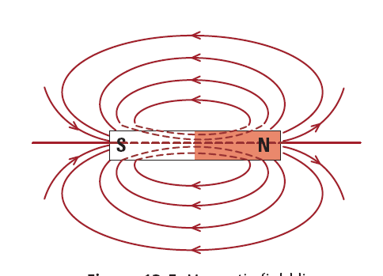

Slide 8
A substance which can become magnetized is called a
ferromagnetic substance.
There are three metals which are ferromagnetic.
Iron, Fe.
2. Nickel, Ni.
3. Cobalt, Co.
Any mixture of these three metals will also be
ferromagnetic.
steel contains iron, so steel is ferromagnetic.

Slide 9
Domain Theory – All large magnets are made up of smaller and rotatable magnets, called dipoles, which can interact with other dipoles close by. If dipoles line up, then a small magnetic domain is produced.
Magnetic Domain
Magnetic Dipole

Slide 10
If a magnet is placed close to the ferromagnetic substance
then all the magnetic domains will line up.
This will cause the domains to all line up in the same dir
S
N

Slide 11
If a magnet is placed close to the ferromagnetic sub
then all the magnetic domains will line up.
cause the domains to all line up in the same dir
S
N
substance is now magnetized.

Slide 12
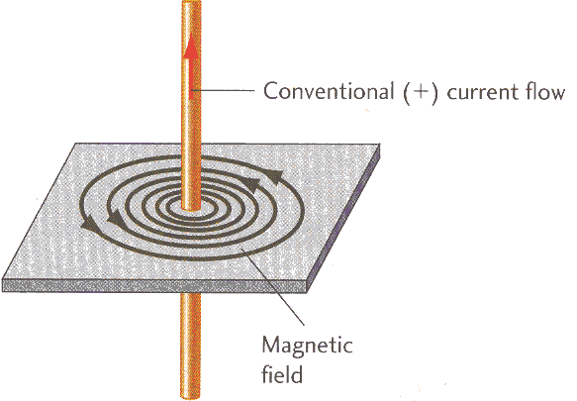
Electromagnets
Electromagnets are conductors which become magnetized when an electrical current flows through it.
Oersted’s Principle – Current moving through a conductor produces a circular magnetic field

Slide 13
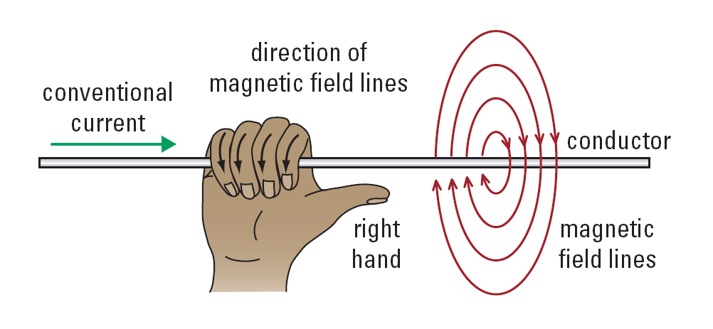
RHR #1: Grasp the conductor with the thumb of the right hand pointing in the direction of the current. The curved fingers point in the direction of the magnetic field around the conductor.

Slide 14
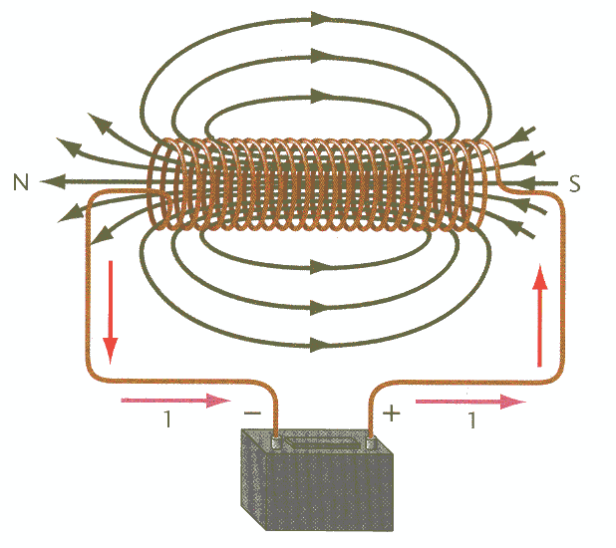
If the straight conductor is coiled around and around, a solenoid is formed.
If the solenoid is connected to a battery, an electromagnet is formed.

Slide 15
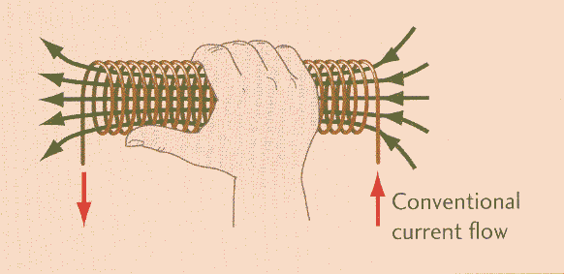
RHR #2: Grasp the coiled solenoid with the right hand such that the curved fingers point in the direction of the
current. The thumb points in the direction of the magnetic field inside the coil. Outside the coil, the thumb points to the north pole of the electromagnet.
N
S

Slide 16
key advantage of an electromagnet over a regular magnet is that it can be turn on and off.
electromagnets are only magnetized when a current is flowing through it.
four properties which affect the strength of an
electromagnet.
1. The current in the coil.
2. The number of turns in the coil.
3. The type of material in the core of the coil.
The diameter of the core in the coil.

Slide 17
HOMEWORK
Read Section 12.1, 12.2, and 12.4
Review Tutorials in the sections
Questions 1 – 6 pg 552
1 – 7 pg 556
1 – 4, 7 pg 562

